Slide 1
HanaBudget
An Expense Tracker App

Slide 2
The Team!
Mark Denina
Alexis Cruz Aboytes
@mdenina1
@ChicoQuemador1
Link to repository:
https://github.com/ChicoQuemador1/HanaBudget

Slide 3
The Pitch?
Meet HanaBudget: the friendly and simple expense tracker app. Built with Flutter for a smooth ride on any mobile device and utilizing Atlas by MongoDB for local database management, it ensures your financial data is always at your fingertips, secure, and up-to-date. Whether you’re watching your spending, setting up budget goals, or just curious where your money goes, HanaBudget has your back. It’s your go-to finance buddy in this busy, connected world, helping you stay on top of your money game without breaking a sweat.

Slide 4
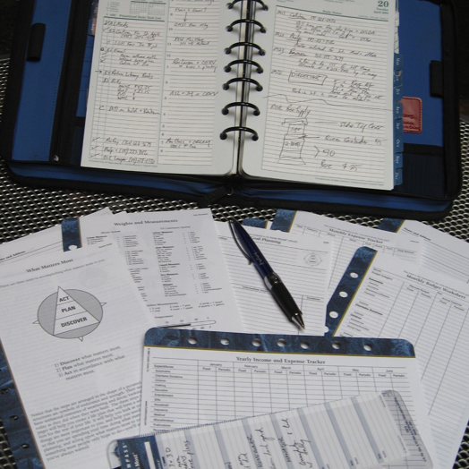
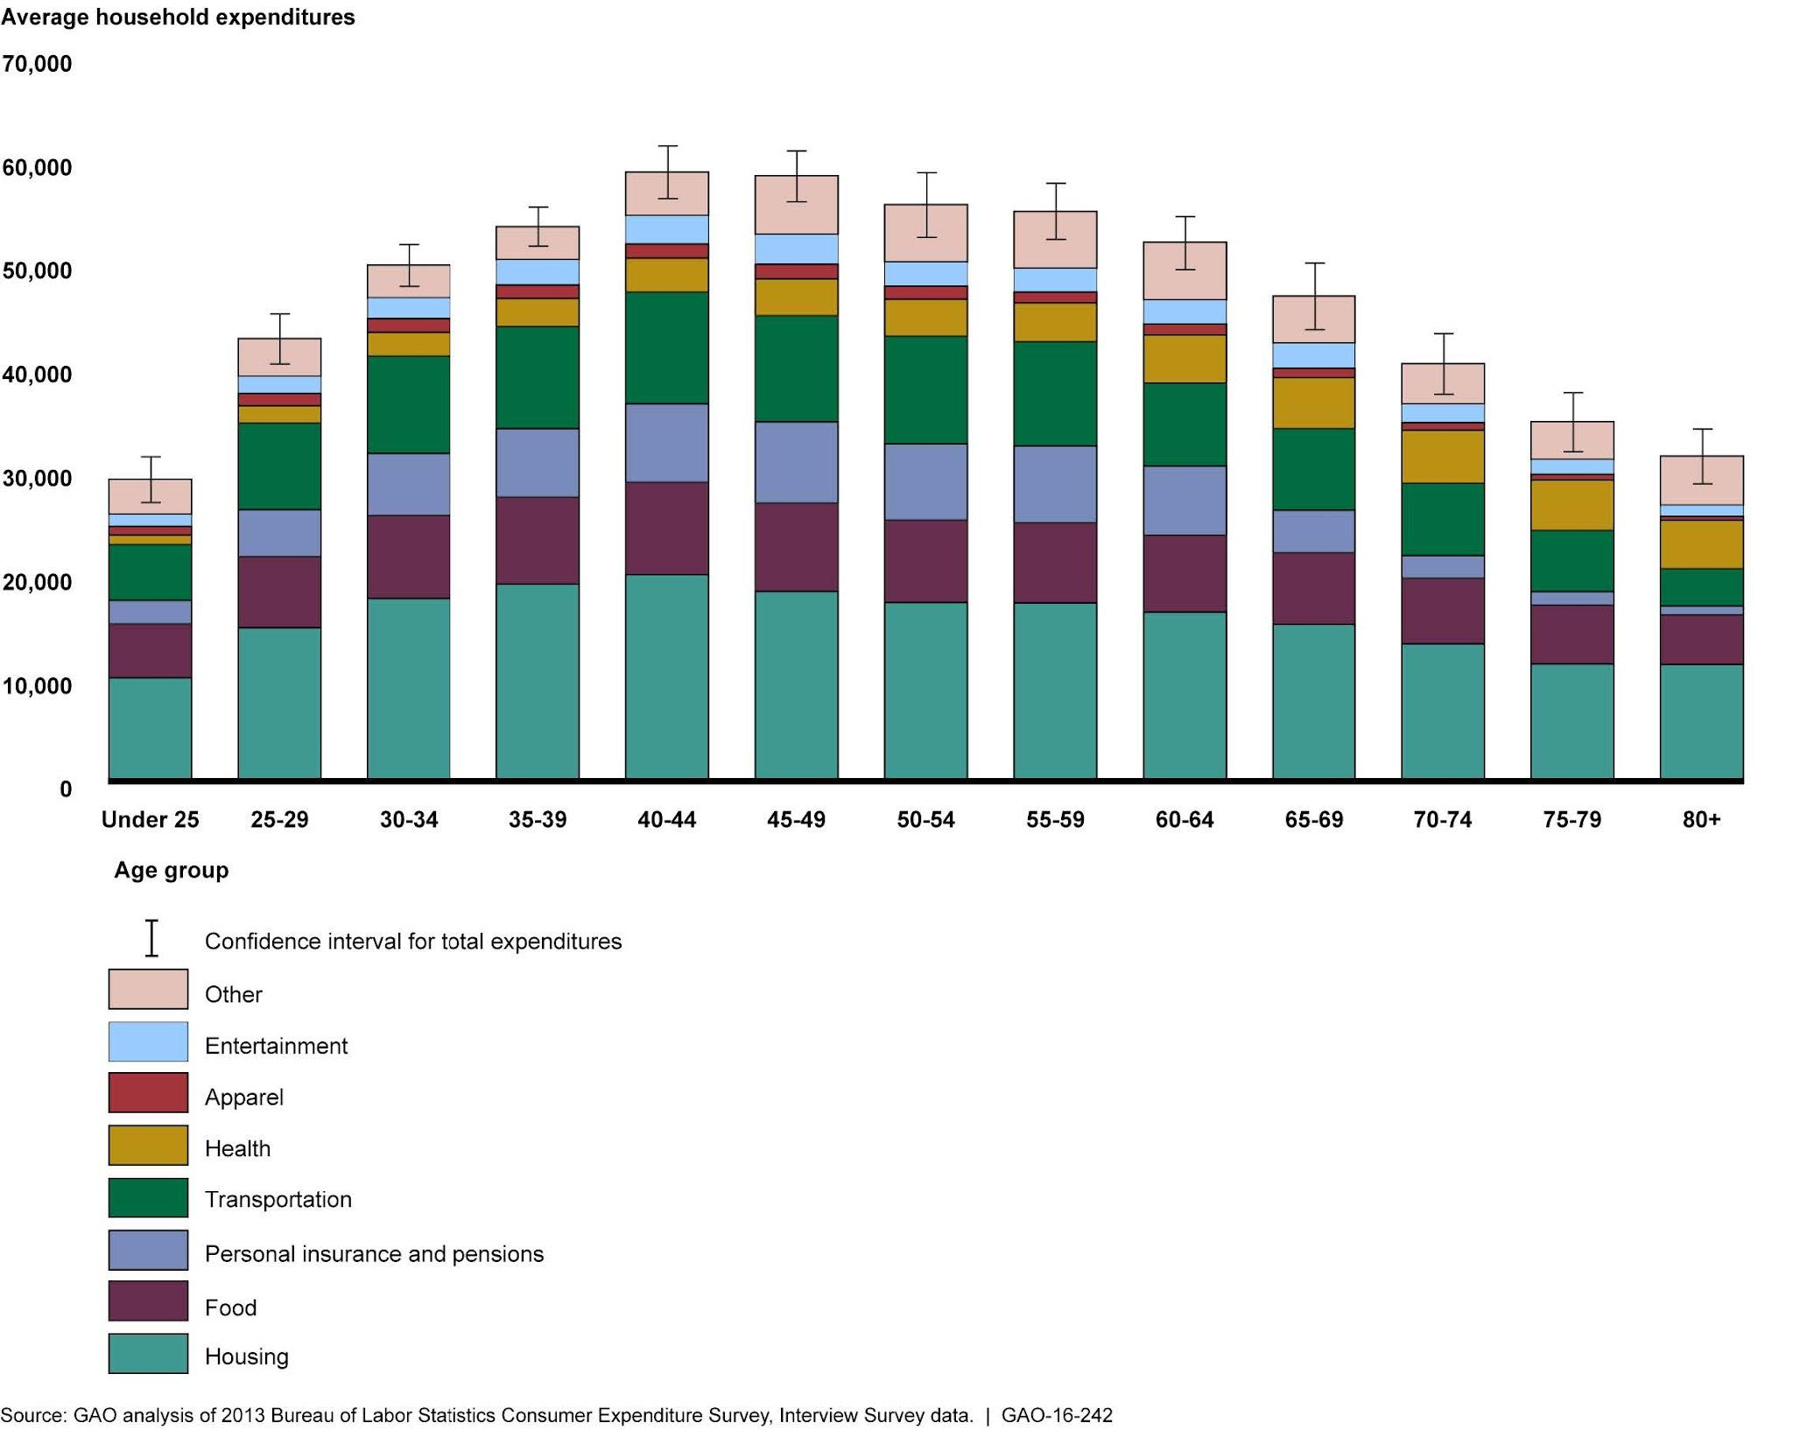
Problems with Trackers Today:
Complex
Limited Customization
Difficult to analyze
Our Solution:
Made simpler
Easy to read/access
Customizable to any user

Slide 5
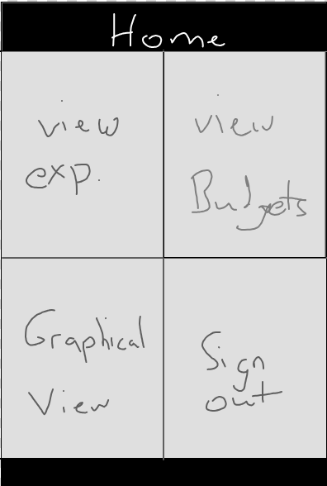
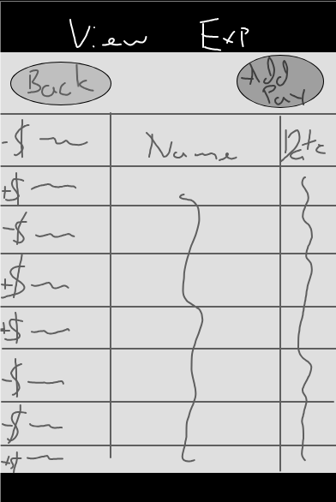
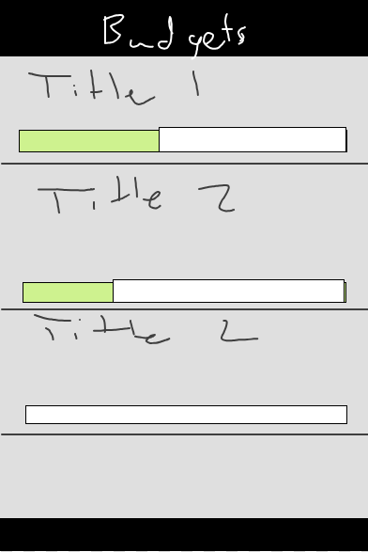
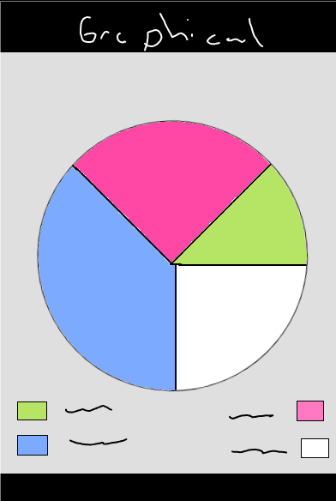
Layouts

Slide 6
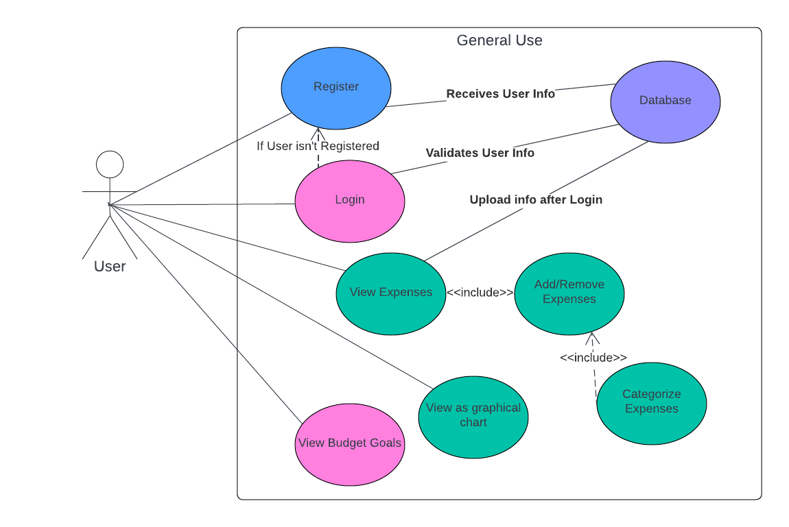
01 Home Screen
User Experience

Slide 7
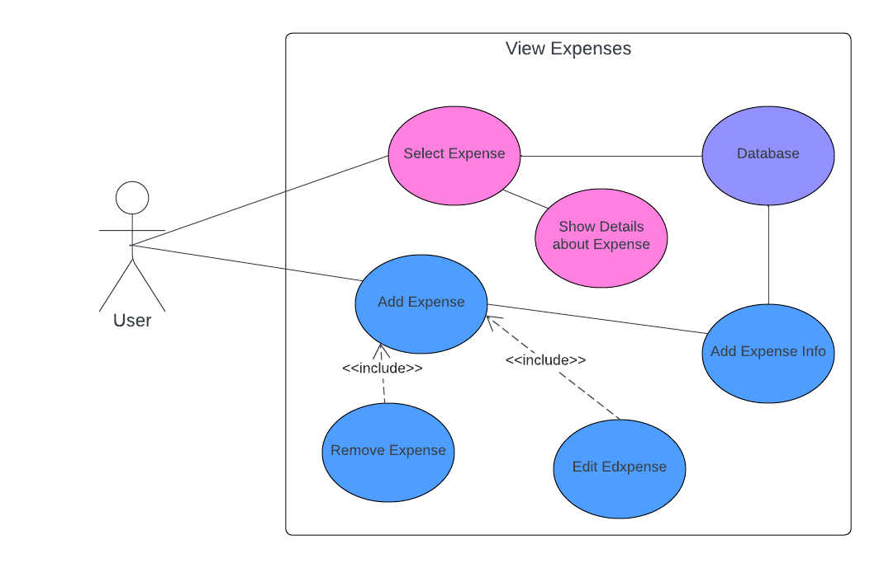
02 Expenses
User Experience

Slide 8
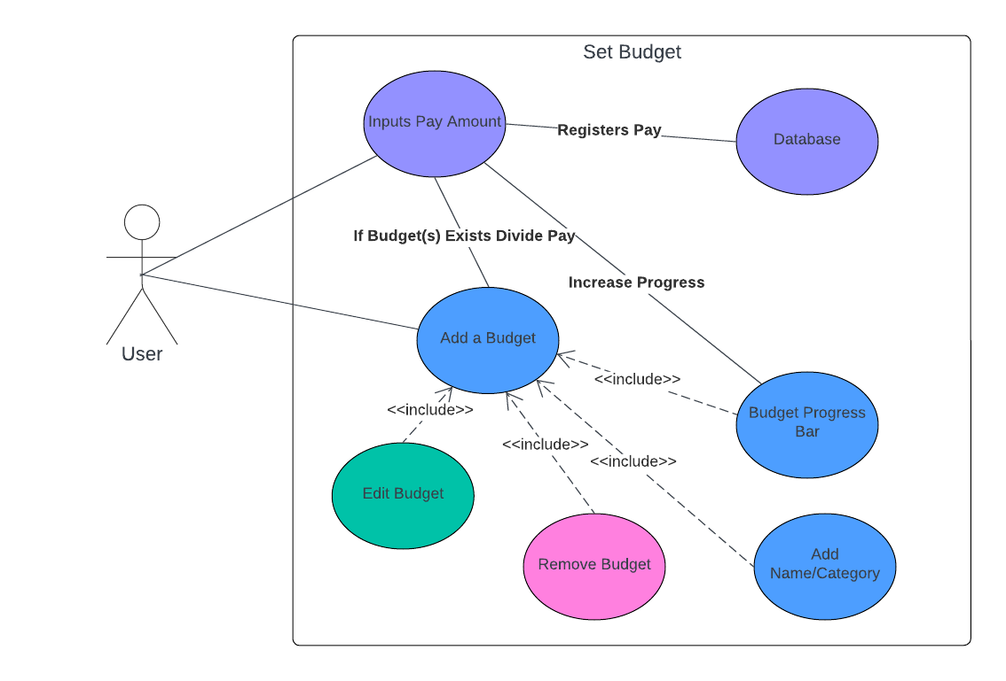
03 Budget
User Experience

Slide 9
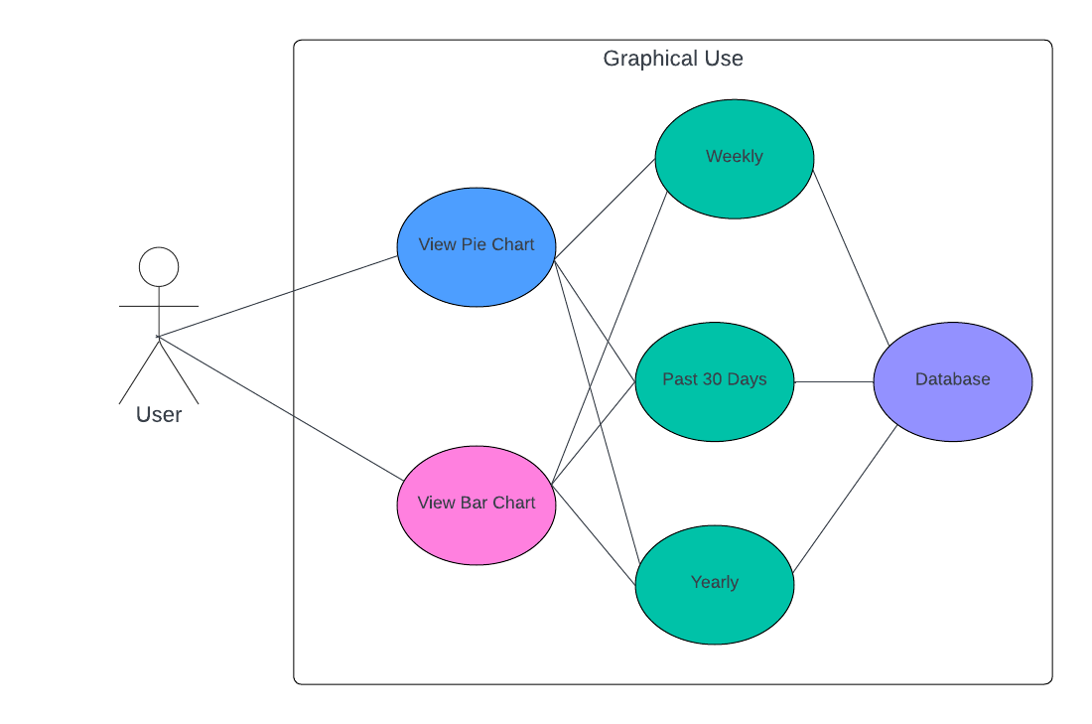
04 Graphical View
User Experience

Slide 10
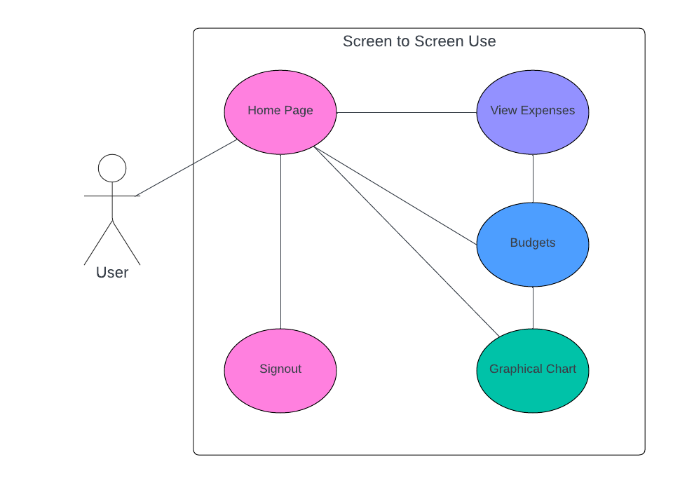
Functionality
Screen to Screen

Slide 11
Iterative Design – Test Case 1
Feedback Loops
After releasing a budgeting feature for beta testing, we collect “user feedback” and “usage data analysis”. A significant portion of feedback indicates that while users like the flexibility of adaptive budgeting, they are often surprised by the suggested adjustments and wish to understand them a bit more.
Improvements
An improvement we could add is implementing a Budget Insight functionality that explains why adjustments are suggested, that are based on past spending trends, upcoming bills, and the user’s income variability.

Slide 12
Iterative Design – Test Case 2
Feedback Loops
Feedback collected from “user surveys” and “app usage analytics” indicates that the multi-step process discourages frequent use form users, especially for logging small transactions.
Improvements
A change that can be made is to implement a "Quick Add" button on the dashboard, allowing users to enter an expense amount and select a category without leaving the home screen.

